Slide 1
ATP

Slide 2
Learning Objective
The structure of ADP and ATP as phosphorylated nucleotides
Comprising a pentose sugar, a nitrogenous base and inorganic phosphate

Slide 3
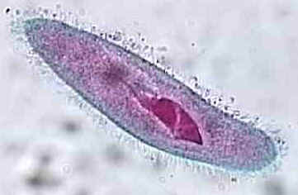
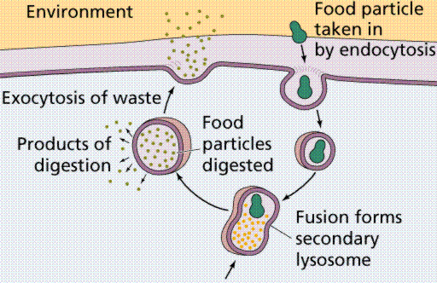
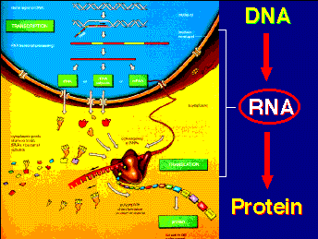
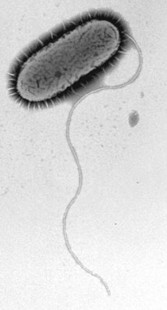
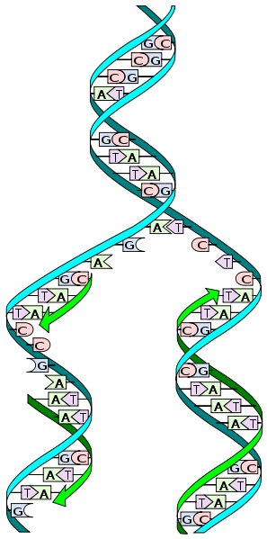
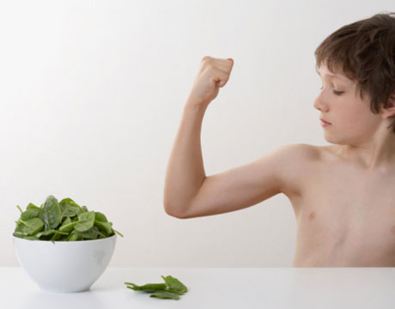
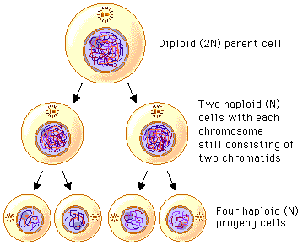
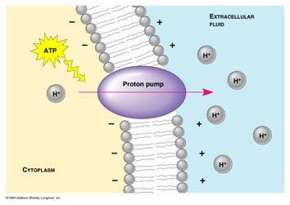
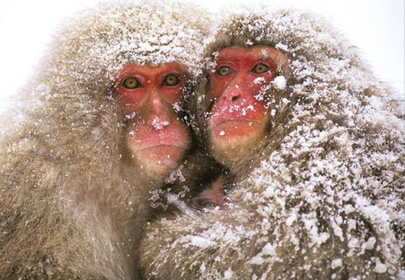
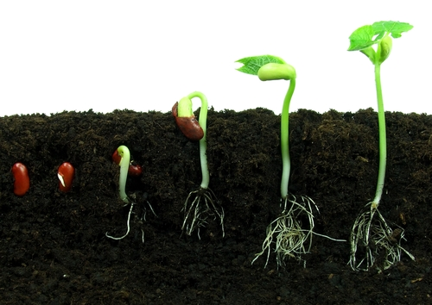
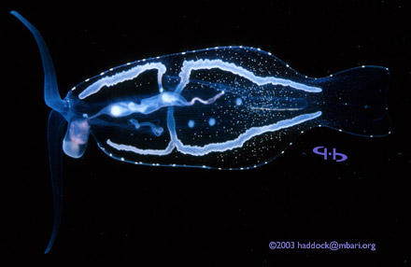
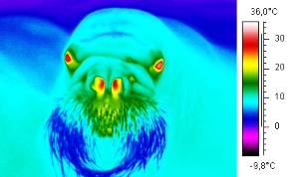
Why do organisms need energy?
Page 80
Three main uses of energy
Synthesis e.g. making bigger molecules
Transport eg active transport
Movement eg muscle contraction

Slide 4
ATP- A universal currency
It is a molecule which provides energy for most cells in all kingdoms
It powers most reactions in cells

Slide 5
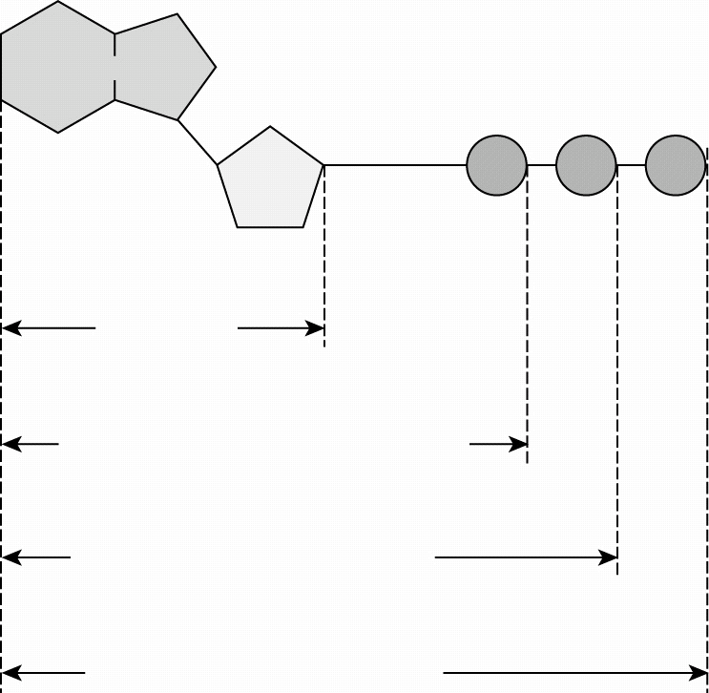
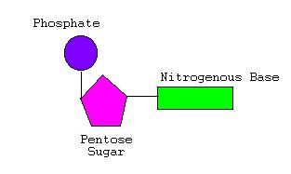
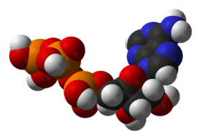
What is ATP?
Adenosine triphosphate
A phosphorylated nucleotide
phosphate group(s) added
sugar, base and phosphate group
Base
S
P

Slide 6
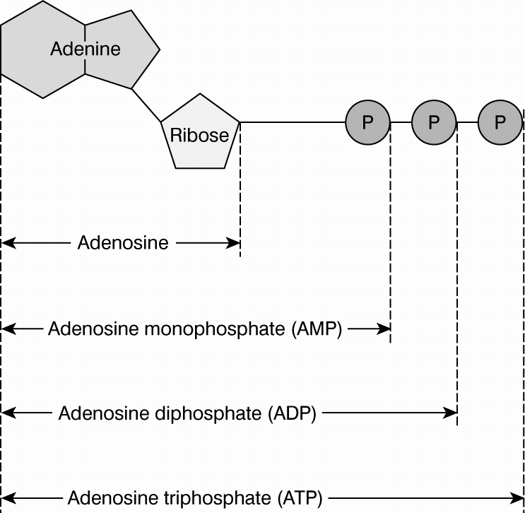
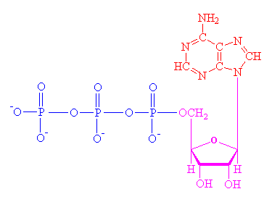
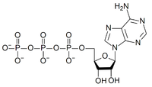
Base = adenine
Sugar = Ribose

Slide 7
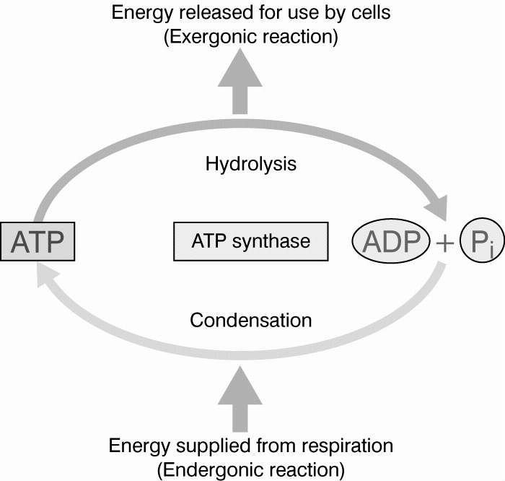
ADP + P_{i} ATP
The energy release is ‘coupled’ to an energy using process.
As the energy is released it is immediately used.
The energy released from the hydrolysis of ATP is an immediate source of energy for biological processes
H₂O
ATP is constantly used and reformed
The hydrolysis of ATP releases 30.6 kJ mol⁻¹

Slide 8
Energy stores
1. Where does the energy come from to make ATP?
Other energy reserves such as carbohydrates and fats are used to keep the ATP levels up
2. Why do cells have relatively small quantities of ATP available?
The phosphate bonds are not very stable so only a little energy is stored here
3. Why is it less efficient to couple reactions to the oxidation of glucose or fats?
ATP hydrolysis is a very immediate source of energy compared to oxidation of glucose or fats which involves many steps catalyses by a different enzyme

Slide 9
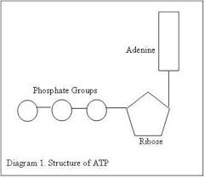
i. Name the parts of the ATP molecule labelled X,Y, Z
X………………………………………………..
Y…………………………………………………
Z………………………………………………...
ii. With reference to the diagram, describe and explain the role of ATP in the cell (3)
X
Z
Y

Slide 10
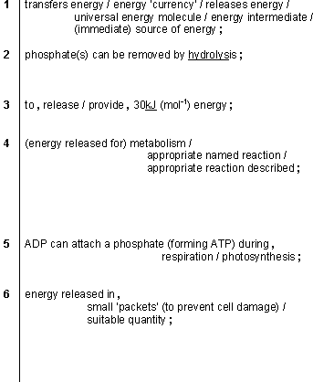
Adenine
Phosphates
Ribose

Slide 11
Advantages of ATP as an energy source
Easily hydrolysed and reformed by condensation (only 1 enzyme is involved).
Small quantities of energy provided rather than a lot which would be wasted as heat
Water soluble (unlike fats and polysaccharides)
Small and easily moved around cells to where ATP is required

Slide 12
Suggest 2 similarities and 2 differences between the structures of DNA and ATP
Similarities
Differences
Both contain a nitrogenous base (adenine)
Both contain phosphate
Both have a pentose sugar
Only adenine in ATP but DNA can have 3 others too Thymine, Cytosine and Guanine
DNA has deoxyribose RNA has ribose
A DNA nucleotide has only 1 phosphate group but ATP has as many as 3
DNA is arranged as a double helix and is a very large macromolecule. ATP is small.

Slide 13
ATP in the course
A greater understanding of the role and synthesis of ATP will be covered in more detail in year13 during the topics of
Photosynthesis
Respiration
Questions about ATP are likely to be very synoptic.

